Slide 2
The Church

Slide 3
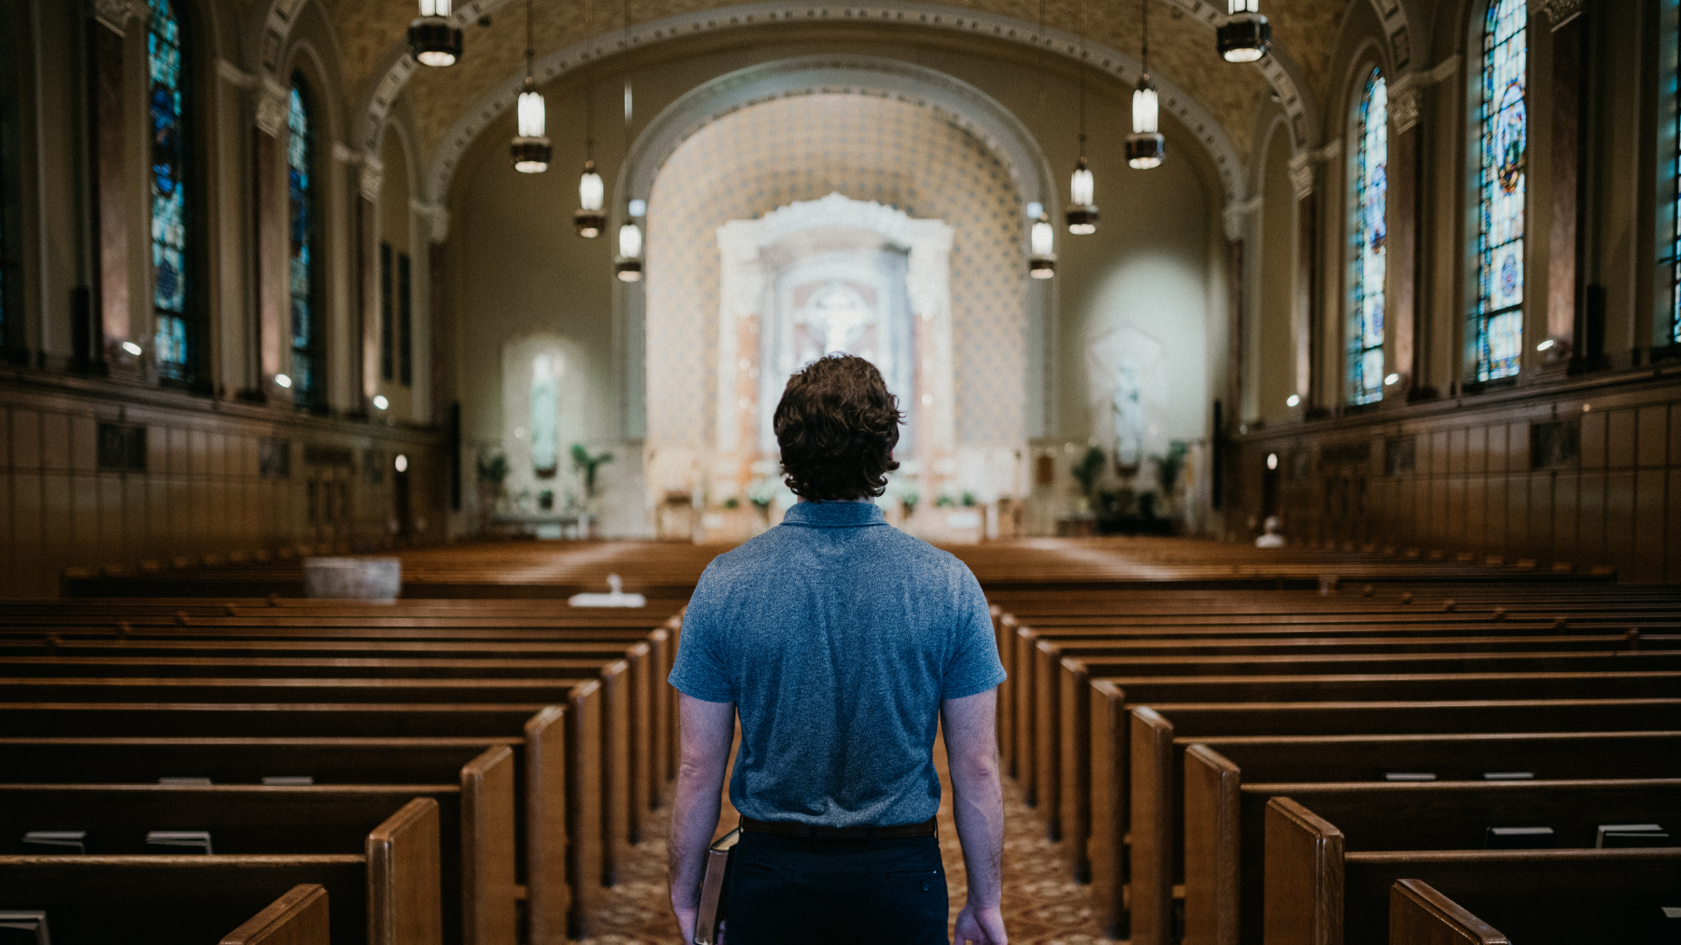

Slide 4
The pre-Christian history of the word had a direct bearing upon its Christian meaning, for the ekklēsia of the NT is a “theocratic democracy” (Lindsay, Church and Ministry in the Early Cents., 4), a society of those who are free, but are always conscious that their freedom springs from obedience to their King.
Church =
The Assembly

Slide 5
“I also say to you that you are Peter, and upon this rock I will build My church; and the gates of Hades will not overpower it.
- Matthew 16:18

Slide 6
The Church is the unique separation and distinction of the people of God.

Slide 7
Two Senses of the Church
Local
1st Corinthians 1:2
universal
Acts 9:31

Slide 8
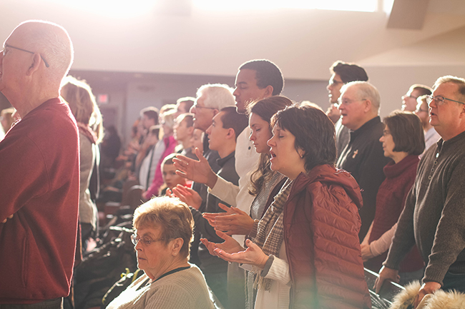
Who is part of the church?
Can people be in our church but not God’s church? (1st John 2:19)
Can people be in God’s church but not our church? (Mark 9:38-40)
Is a church’s standing with God easily visible? (Revelation 3:1)
Acts 2:47

Slide 9
Christ’s Church – Moral Purity
Revelation 2:19-23
Is it easy to select a church based on this?
The issue wasn’t the sermon, but the lives of its members!
Everyone has a personal responsibility to address moral failings within the church.

Slide 10
Christ’s Church – Correct Teaching
Revelation 2:14-16
Jesus notices what is being taught at a church!
The Church’s teaching doesn’t change over time.
2nd Timothy 4:1-5
People don’t always want to hear truth

Slide 11
Christ’s Church – Passion for God
Revelation 3:12-19
Jesus can see our attitude toward Him
What was His attitude toward God’s house? (John 2)
Describe a church that is “lukewarm”
Remember, a church is made up of individuals!

Slide 12
Christ’s Church – Care For Its Members
ROMANS 12:10; James 2
A church should be a family
Care needs to be given for the weak, poor, elderly etc.
This includes spiritual as well as physical well being
We are all members of each other

Slide 13
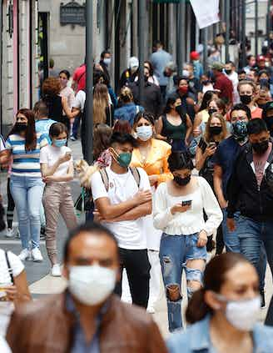
Christ’s Church – A Love for the Lost
Acts 8:4
A church needs be focused on saving the world
It is an individual responsibility
What does the future hold for a church that doesn’t have evangelism on their mind?
Spreading the gospel around the world is also important!

